Slide 1
DSE5300 – Week 2 Lecture
September 7, 2021
Fotios Kokkotos, PhD
kokkotosf@merrimack.edu

Slide 2
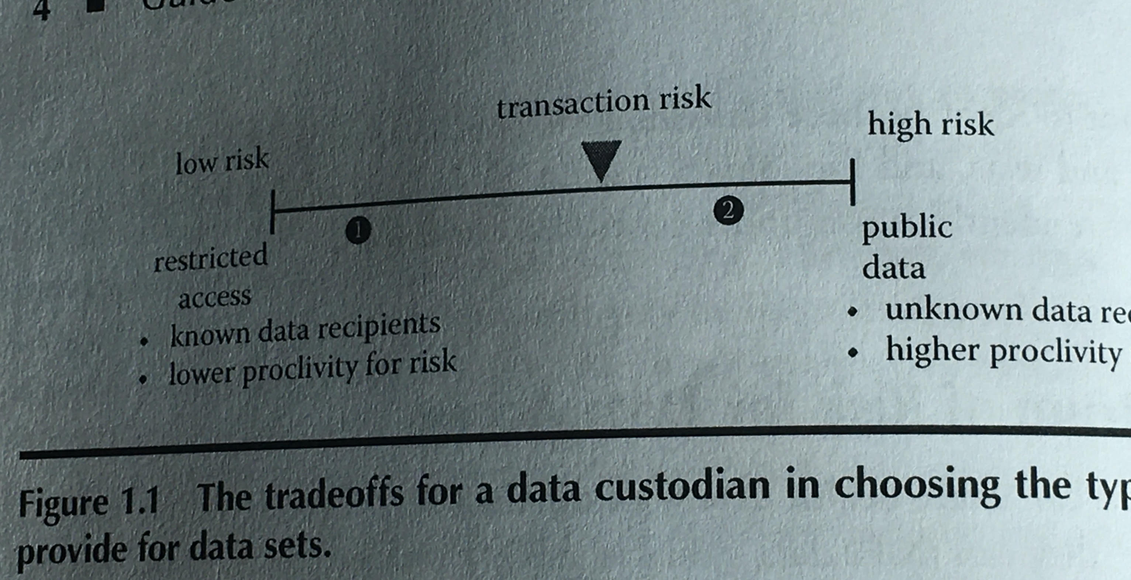
The Spectrum of Risk for Data Access
As a data custodian, what type of access do you choose?

Slide 3
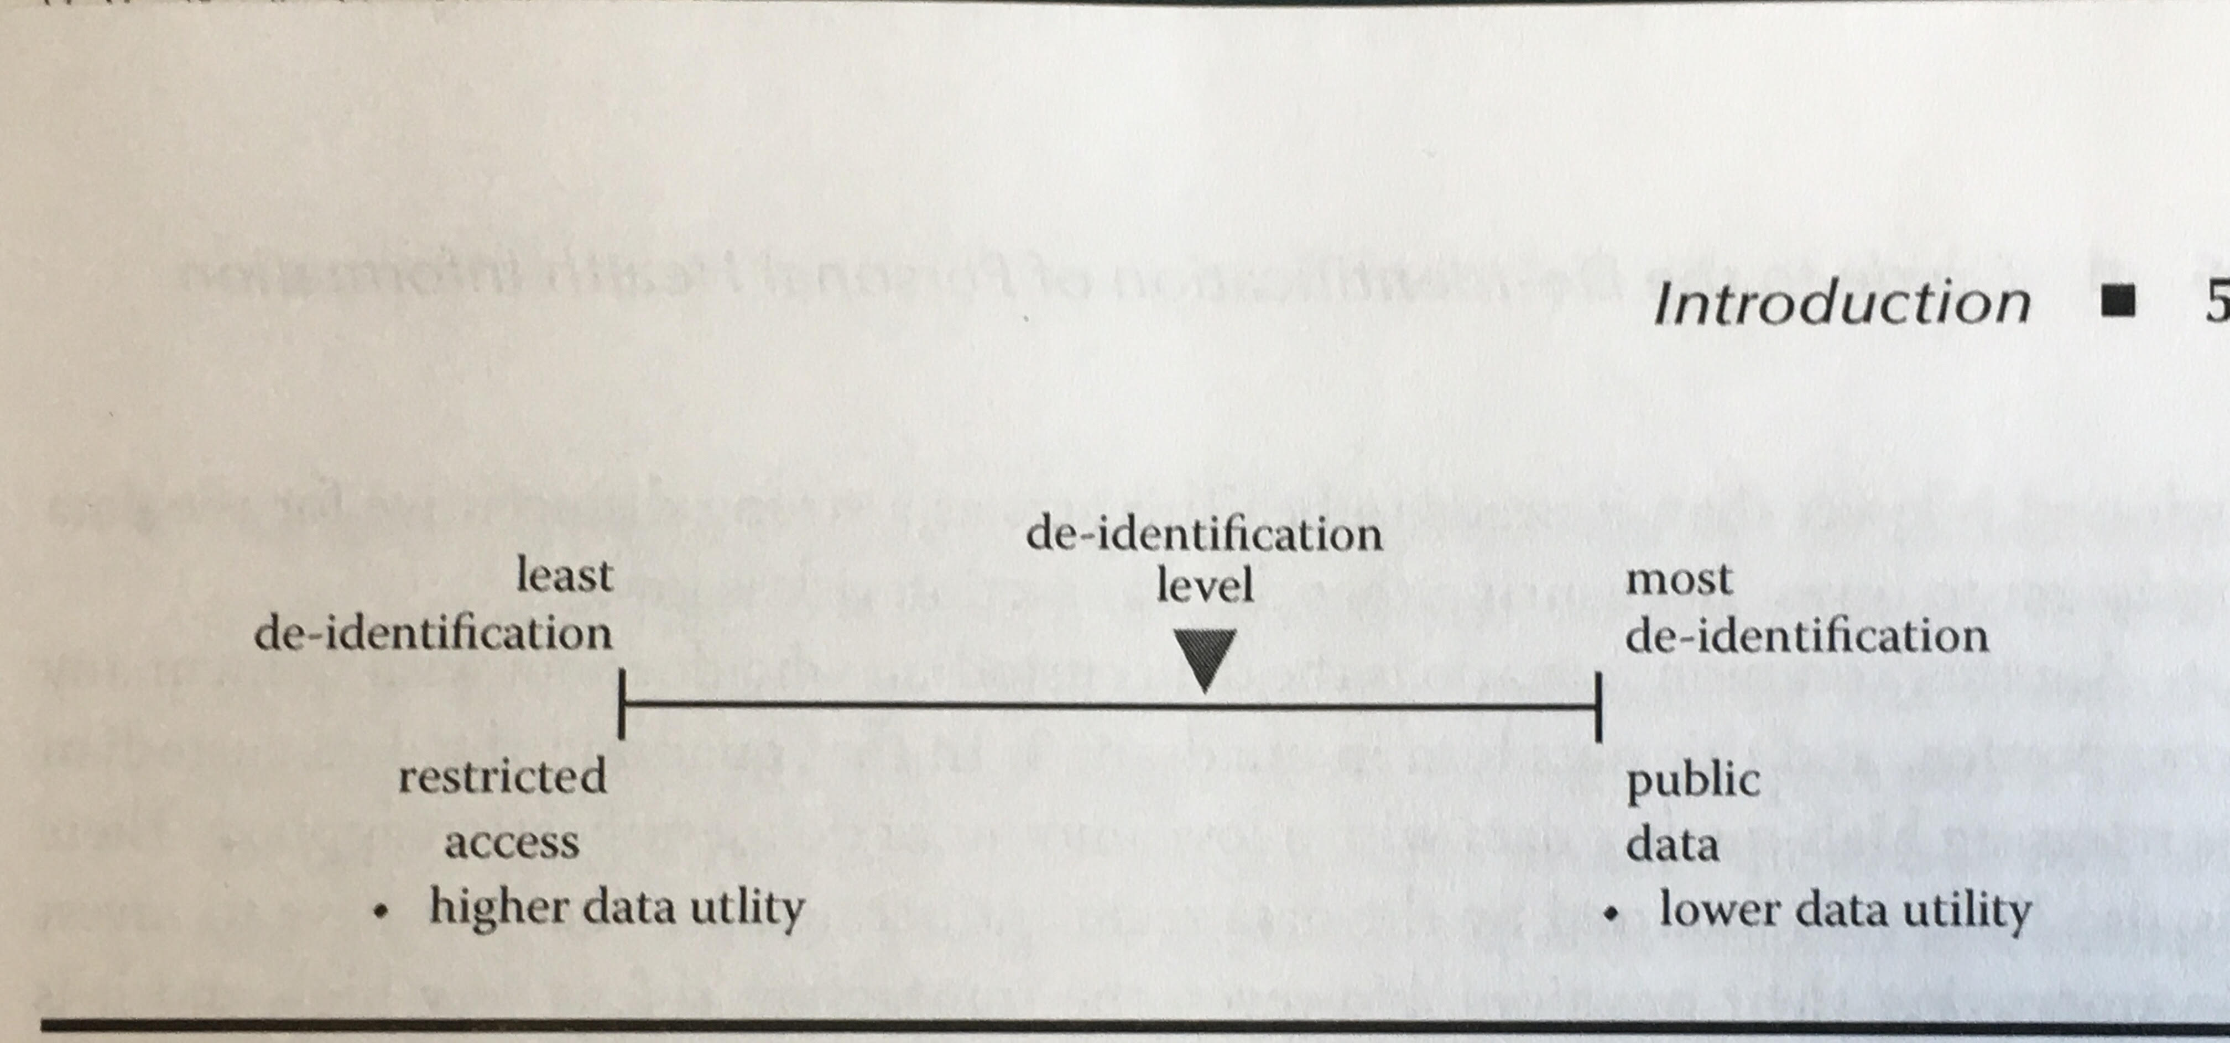
Managing risk
The amount of de-identification can be varied to manage the transaction risk

Slide 4
What is De-Identification?
De-identification algorithms protect against inappropriate disclosure of personal information
There are two kinds of disclosure to be concerned: identity and attribute
If the adversary would be able to determine that record 5 belongs to patient Joe, then this is an identity disclosure
Attribute disclosure occurs when an adversary learns a sensitive attribute about a patient in the database with sufficiently high probability without knowing which specific record belongs to the patient.
Let’s review the following example

Slide 5
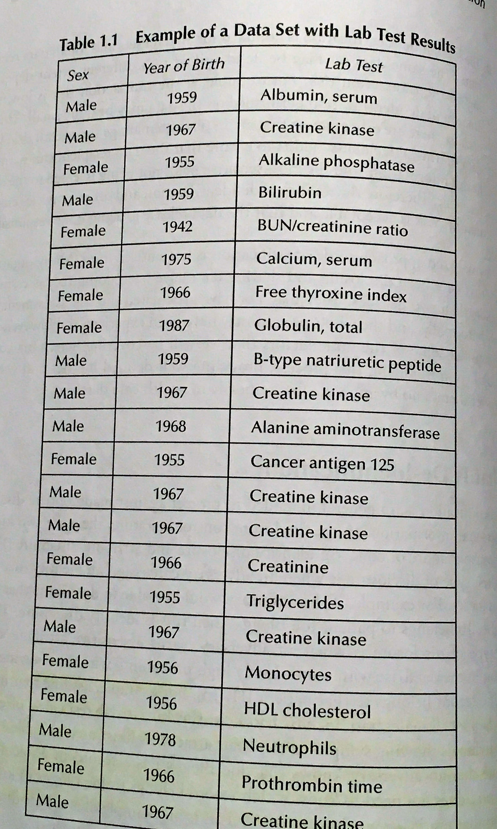
Example of a Data Set with Lab Test Results
Can you spot an attribute disclosure?

Slide 6
What is De-Identification?
Our society primarily focuses on identity disclosure and protections against it. Here is why:
Current legislation and regulations only require protection against identity disclosure when a dataset is de-identified
Protections against attribute disclosure would destroy data utility
For the rest of this course, we will concentrate on health care data applications
But, most (if not all) of these notes can be applied to any industry!

Slide 7
What is HIPAA?
HIPAA: Health Insurance Policy and Accountability Act
The HIPAA Privacy Rule de-identification standards has focused on protections against identity disclosure
HIPAA does not address identifiability risks from attribute disclosure
There are two standards in the HIPAA privacy rule: The 18 Safe Harbor Elements and the Statistical Method

Slide 8
Safe Harbor
This method requires identifiers of the individual, or of relatives, employers, or household members of the individual, to be removed. Examples: names, all geographic subdivisions smaller than a state, all elements of dates, telephone numbers, fax numbers, emails, social security numbers, etc.
Safe Harbor compliant data can still have a high risk of re-identification and it loses its utility fast!

Slide 9
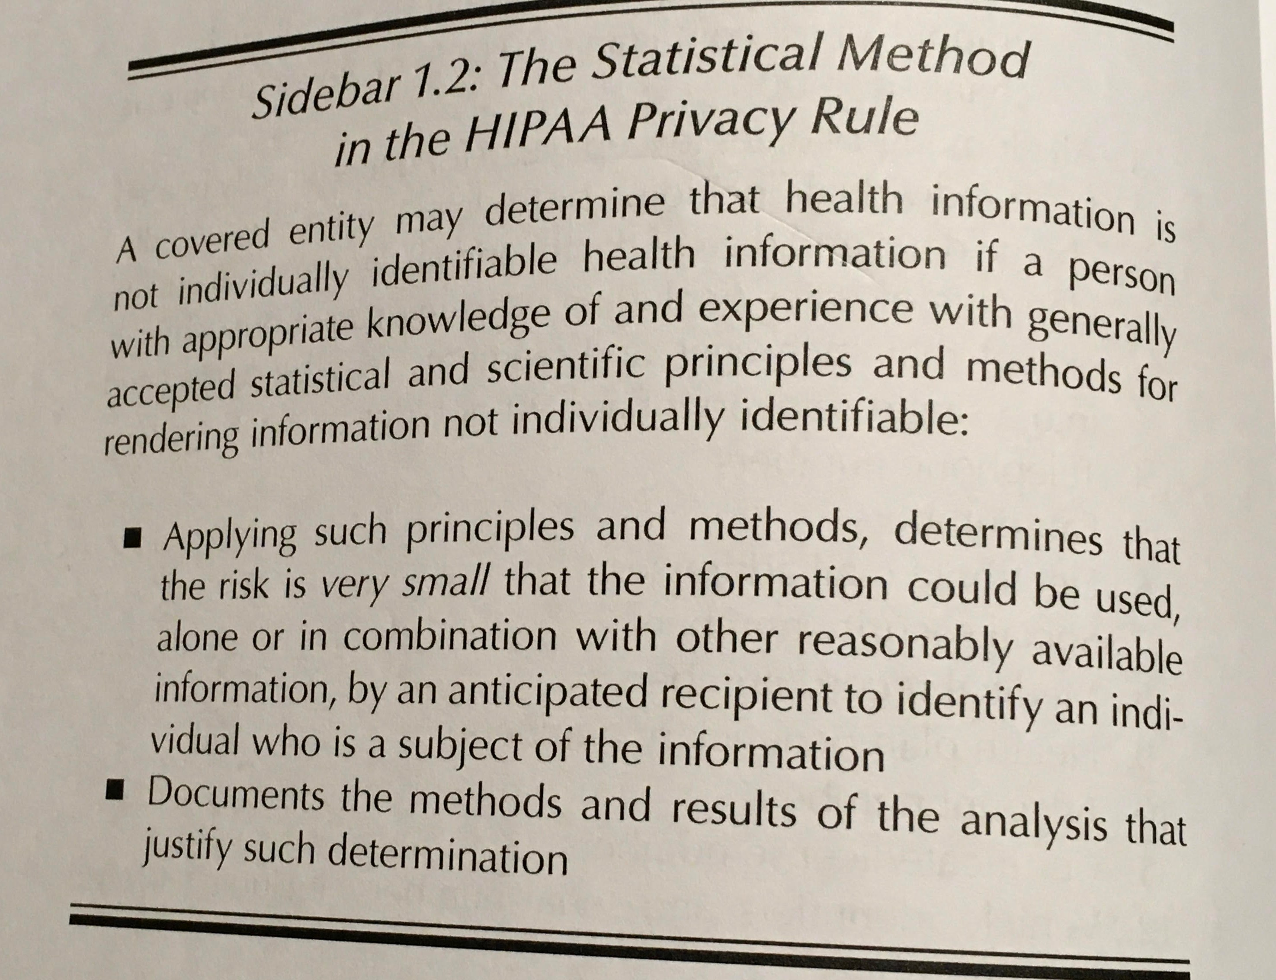
Statistical Method

Slide 10
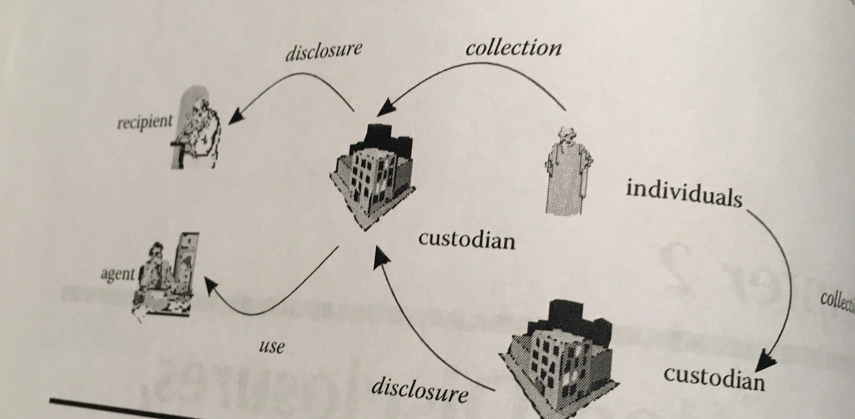
Basic Data Flow

Slide 11
Personal Health Information (PHI)
PHI is information about identifiable individuals
Under the data flow discussed, we have four possible scenarios to consider:
It is mandatory to disclose PHI to a recipient, and no consent is required
(no more discussion needed)
PHI is used by an agent without consent
It is permitted by legislation to disclose PHI to a recipient without consent under the discretion of the custodian
The custodian must de-identify the PHI or obtain consent before disclosing the data to the recipient

Slide 12
Uses of health information by an Agent
While agents are permitted to access PHI, it is often not necessary for them to have the data in identifiable form in order to perform their functions
It would be best to de-identify that information as a risk mitigation exercise, by considering the following three attack scenarios by an agent:
An insider inadvertently or maliciously causing a data breach
An insider determining the identify of individuals
Risk of data breaches at subcontractors

Slide 13
Uses of health information by an Agent
Privacy and security data breaches by insiders are relatively common
Internal breaches come from people who have legitimate access to the data, but whose behavior jeopardizes the firm’s security and privacy. About 27% of such breaches are due to insiders
Monetary losses from breaches were due to malicious and nonmalicious insiders. Examples: employees who have access to critical data and engage in unauthorized explorations, individuals who join an organization with the intent to commit some kind of fraud or employees who lose their laptop after they put sensitive information on it.
Bottom Line: If data sets used by custodians or subcontractors are not de-identified properly, insiders have a unique ability to re-identify the records

Slide 14
Peeping and Snooping
There is a growing phenomenon with electronic medical records – snooping
It has been illustrated that even health care professionals and their staff are tempted to look at the medical information of other people that they know, famous people or even people that they do not know
Spontaneous recognition
De-identification can protect against these types of attempts by making difficult for the culprit to determine PHI

Slide 15
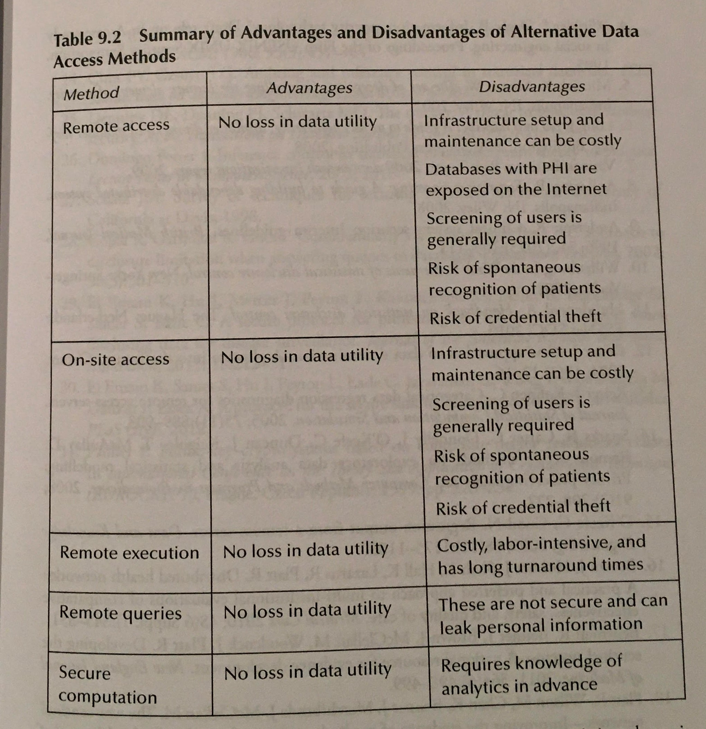
Alternative Methods for Data Access: Do we still need de-identification?

Slide 16
Questions?
Check out Merrimack’s Data Science Minor!

